Slide 1
Linux Network Security Pt. II
Unit Linux, Day 4
Cybersecurity Boot Camp |
30 April 2019

Slide 2
Today’s Goals
By the end of class, you will be able to:
Interpreting existing IDS rules
Write custom snort rules
Generate traffic logs and alerts with Snort
Notes:
But today, we’re going to… Review goals, address questions.

Slide 3
iptables Rules Warm up
In this exercise, you'll interpret a handful of iptables rules to prepare for later exercises on Snort attack signatures.
Instructions:
Using iptables
Use the iptables manpages to answer the questions below: http://ipset.netfilter.org/iptables.man.html
What command do you use to delete all iptables rules?
Which command would you use to set the INPUT and OUTPUT default chains to DROP?
Reading Rules
Read the rules below, and answer the following questions.
What does each rule do?
Which service do these rules enable?
What would happen if the first rule were implemented without the second? Vice-versa?
iptables -A INPUT -i eth0 -p tcp --dport 80 -m state --state NEW,ESTABLISHED -j ACCEPT
iptables -A OUTPUT -o eth0 -p tcp --sport 80 -m state --state ESTABLISHED -j ACCEPT
Read the rules below, and answer the following questions.
Which devices are allowed to make connections to host port 3306?
Which service do these rules enable?
Why does this rule only allow traffic from this specific subnet?
ptables -A INPUT -i eth0 -p tcp -s 192.168.100.0/24 --dport 3306 -m state --state NEW,ESTABLISHED -j ACCEPT
iptables -A OUTPUT -o eth0 -p tcp --sport 3306 -m state --state ESTABLISHED -j ACCEPT
As a challenge, research the following about the rule below.
1. What is the `nat` table? 2. What is the PREROUTING chain?
3. What is DNAT? 4. What is the relationship between `--dport 422` and `192.168.102.37:22`?
iptables -t nat -A PREROUTING -p tcp -d 192.168.102.37 --dport 422 -j DNAT --to 192.168.102.37:22

Slide 4
Introducing Snort

Slide 5
Intrusion Detection System
Intrusion Detection System are automated tools that analyze firewall logs
Reads logs in real time and notifies administrators when they detect something suspicious
Attack signatures are patterns in network traffic that act as the “fingerprints” of malicious activity
ID systems implement rules specifying what action it should take when it recognizes attack signature

Slide 6

Introducing Snort
Snort is a popular, open-source IDS
Captures packets from the NIC then scans for attack signatures
Generates logs and alerts whenever it identifies traffic matching the signature

Slide 7
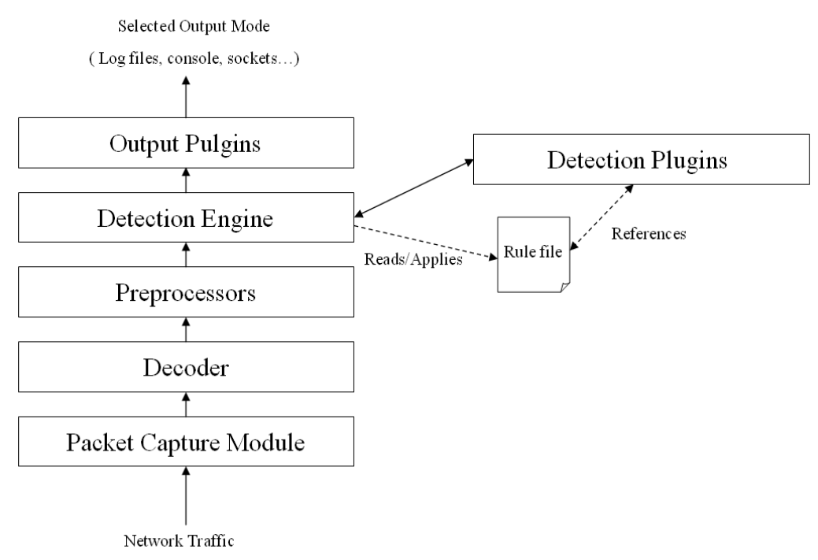
Snort works by piping traffic through a series of analyzers...

Slide 8
Packet Capture Module: Captures packets from the NIC. Based on the popular packet programming library libpcap

Slide 9
Decoder: Fits the captured packers that should be flagged for later inspection

Slide 10
Preprocessors: Filters that identify packets that should be flagged for later inspection

Slide 11
Rules Files: Plain-text files which contain a list of rules in Snort syntax.
This syntax specifies the protocols, addresses, and byte sequences to monitor traffic for; any output plug-ins needed for Snort to generate the right alerts/logs; and other minutiae students will encounter in the exercises. Those rules files can be updated by the administrator.

Slide 12
Detection Plug-Ins: Modules used to efficiently identify patterns whenever a rule is evaluated

Slide 13
Detection Engine: reads the Rules files, then uses Detection Plug-ins to match packets against the rules

Slide 14
Output Plugins: Modules which allow custom formatting of notifications, such as alerts and logs

Slide 15
The Rules
Snort works by:
First reading a configuration file, specifying where to find rules files, preprocessors, etc.
Loading these rules and plug-ins
Capturing packets and monitoring traffic for patterns specified in the loaded rules
When traffic matches a rule pattern, Snort generates an alert and/or logs the matching packet for later inspection

Slide 16
The Rules
Rules are the most commonly edited files by Snort admin
/etc/snort/rules/
Rules can direct Snort to monitor:
OSI Layer
Source/Destination Address
Byte Sequences

Slide 17
The Rules
alert ip any any -> any any {msg “IP Packet Detected”;}
Logs the message “IP Packet Detected “ when it detects IP packets

Slide 18
The Rules
alert ip any any -> any any {msg “IP Packet Detected”;}
alert is the action taken

Slide 19
The Rules
alert ip any any -> any any {msg “IP Packet Detected”;}
alert is the action taken
ip means: “Apply this rule to all IP packets…”

Slide 20
The Rules
alert ip any any -> any any {msg “IP Packet Detected”;}
alert is the action taken
ip means: “Apply this rule to all IP packets…”
any any: “...Which comes from any source IP Address and any source port”

Slide 21
The Rules
alert ip any any -> any any {msg “IP Packet Detected”;}
alert is the action taken
ip means: “Apply this rule to all IP packets…”
any any: “...Which comes from any source IP Address and any source port”
-> any any: “...And is bound for any IP Address and any destination port.”

Slide 22
The Rules
alert ip any any -> any any {msg “IP Packet Detected”;}
alert is the action taken
ip means: “Apply this rule to all IP packets…”
any any: “...Which comes from any source IP Address and any source port”
-> any any: “...And is bound for any IP Address and any destination port.”
{msg “IP Packet Detected”;}is the message to print with the alert

Slide 23
iptables Rules Warm up
In this exercise, you'll explore a Snort installation to: Familiarize yourself with Snort's directory structure; Inspect the Snort configuration file; Examine Snort community rules
1. The Snort Configuration File
Begin by moving into /etc/snort. Then, answer the questions below.
List the four directories in /etc/snort, and explain what each is for.
Run: grep -in step snort.conf.
How many steps are there to configuring Snort?
Open snort.conf in nano. Scroll down to Step 1.
What kind of information do you configure in Step 1?
How would you configure Snort to protect the home network 192.168.1.0/24? Note: Don't actually change the config file—just write down how you'd do this.
Note: You can open the file at one of the line numbers from the grep output with nano +<Line Number> snort.conf.
Scroll down to Step 7.
How do you add rules to Snort?
Which rules are included by default?
Edit the file to include local.rules.
2. Inspecting Rules
Navigate to /etc/snort/rules.
How many lines are in the files local.rules, community.rules, and sql.rules?
Hint: wc -l
Run the following command to print the last rule in each file:
tail -n 1 {local,sql,community}.rules
For each rule you see, identify the following:
What action does snort take when it matches this rule's pattern?
Which protocol does each rule watch for?
What are the source/destination addresses the rule monitors?
What kind of activity does each rule monitor for (e.g., command and control messages in the packet? embedded viruses? etc.)
Note the content keyword in all three words. Refer to the documentation at: http://manual-snort-org.s3-website-us-east-1.amazonaws.com/node32.html#SECTION00451000000000000000
What does the content keyword allow you to do?
What does the content keyword in the last rule in local.rules do?

Slide 24
Running Snort

Slide 25
Snort in the Command Line
Running Snort in the command line is important to:
identify suspicious activity in packet captures
quickly test different configurations
Snort has command-line utility to make it easy

Slide 26
[Instructor Demo]

Slide 27
Running Snort
In this exercise, you will:
Launch Snort on your Linux machine
Inspect the alerts and logs it generates
Identify which rule(s) were triggered
Instructions:
Starting Snort
Begin by launching Snort in packet-capture mode. Be sure to enable verbose mode, and pass the correct path to snort.conf.
Watch the packet capture to verify that you're logging traffic. Then, stop Snort with Ctrl + C.
Run: snort --help | less. Find out what the -q flag does.
Restart Snort, but pass the -q flag, and not the -v flag. Note what happens. Then, stop Snort.
Find out how to enable "full Alerts".
Hint: Refer to the Snort documentation at: http://books.gigatux.nl/mirror/snortids/0596006616/snortids-CHP-3-SECT-3.html
Launch Snort in quiet mode with full alerts, and put it in the background with &. Run ps to ensure that Snort is running.
Move to /var/log/snort. Check how many lines are in alert twice in a row, and note what you see.
Hint: Use wc -l.
Run: head alert. Which two alerts were logged when you first ran Snort?
Run: tail alert. Which alert(s) was/were logged most recently?
Which IP addresses did Snort log traffic to/from?
Finding Rules
Move to /etc/snort/rules.
Find out which rules fired the alerts in /var/log/snort/alert.
Hint: Use grep to search for the name/title of each alert in community.rules. Write down the sidof each rule that pops up. You'll find this at the very end of the rule definition, beforerev`.

Slide 28
Snort Rules In-Depth
As you saw in the last exercise, rules can get pretty complicated…
Like this PROTOCOL-ICMP Ping Unix rule:
alert icmp $EXTERNAL_NET any -> $HOME_NET any (msg:"PROTOCOL-ICMP PING Unix"; itype:8; content:"|10 11 12 13 14 15 16 17 18 19 1A 1B 1C 1D 1E 1F|"; depth:32; metadata:ruleset community; classtype:misc-activity; sid:366; rev:11;)
But we can simplify it by breaking it down into distinct components:
Action: This rule tells Snort to alert and log packets that trigger this rule.
Protocol: icmp tells Snort to apply this rule only to ICMP traffic.
Source / Destination Addresses: $EXTERNAL_NET any -> $HOME_NET any means any packet from outside the local subnet into the local network that matches the rule will fire an alert.
Rule Options: The complicated contents at the end of the rule are rule options. These modify what the rule looks for; how it prints its output; and other properties of the rule.

Slide 29
Snort Rules In-Depth
As you saw in the last exercise, rules can get pretty complicated…
Like this PROTOCOL-ICMP Ping Unix rule:
alert icmp $EXTERNAL_NET any -> $HOME_NET any (msg:"PROTOCOL-ICMP PING Unix"; itype:8; content:"|10 11 12 13 14 15 16 17 18 19 1A 1B 1C 1D 1E 1F|"; depth:32; metadata:ruleset community; classtype:misc-activity; sid:366; rev:11;)
But we can simplify it by breaking it down into distinct component.
The rule options are the most complicated portion of this rule, so you'll focus on that next...

Slide 30
Rules Option
(msg:"PROTOCOL-ICMP PING Unix"; itype:8; content:"|10 11 12 13 14 15 16 17 18 19 1A 1B 1C 1D 1E 1F|"; depth:32; metadata:ruleset community; classtype:misc-activity; sid:366; rev:11;)
msg: The string to log when this rule is triggered.
itype: Check for a specific type of ICMP packet. Type 8 is an ECHO packet.
content: Data to look for inside the packet. This sequence of data is the numbers 10 through 1f in hexadecimal. This is just junk data sent in ping packets. "Live" data wouldn't have this content.
depth: Specifies how many bytes into the packet Snort should look for content. If it doesn't find the content string in the first 32 bytes, the rule won't fire.
metadata: Contains administrative information about the rule. In this case, the metadata tells us this is a community rule.
classtype: Specifies what kind of network activity this is.
sid: The ID of the rule.
rev: The Revision ID. This is essentially a version for the rule.

Slide 31
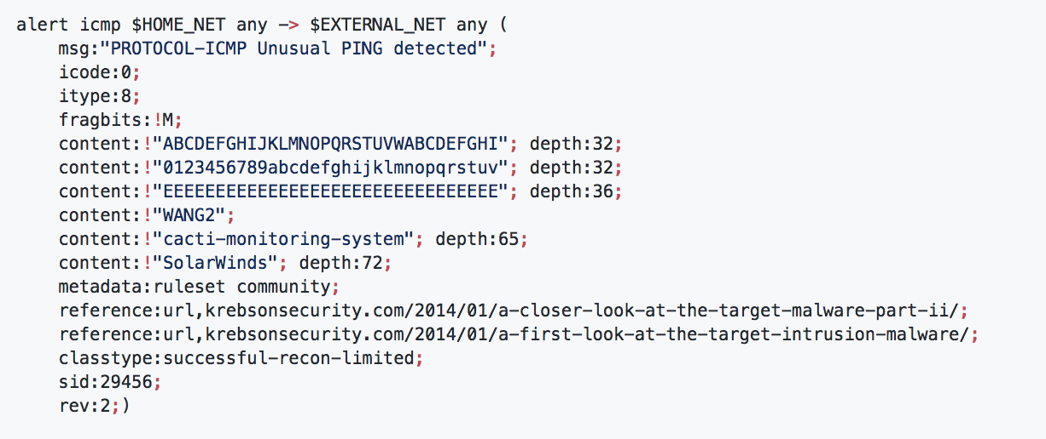
Interpreting Snort Rules
In this exercise, you'll:
Interpret the rules that fired in the previous exercise
Interpret new rules
Use the Snort documentation to research additional rule options
Instructions:
Explain the below ICMP Echo Reply rules. Be sure to identify the:
Action
Protocol
Source/destination addresses
Meaning of each new rule option
alert icmp $EXTERNAL_NET any -> $HOME_NET any (msg:"PROTOCOL-ICMP Echo Reply"; icode:0; itype:0; metadata:ruleset community; classtype:misc-activity; sid:408; rev:8;) alert icmp $EXTERNAL_NET any -> $HOME_NET any (msg:"PROTOCOL-ICMP Echo Reply undefined code"; icode:>0; itype:0; metadata:ruleset community; classtype:misc-activity; sid:409; rev:10;)
Then:
Explain the ICMP Unusual PING rule. Be sure to identify the:
Action
Protocol
Source/destination addresses
Meaning of each new rule option
There are multiple content options in this rule.
Important Note: There's an exclamation mark in front of each content string.
Use the documentation to find out what this means.
Why do you suppose this rule includes so many?
Continued on next slide.

Slide 32
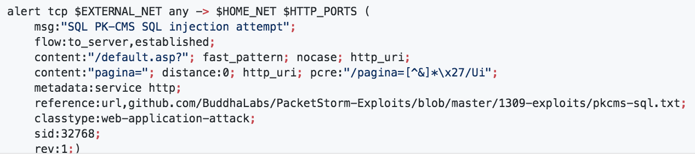
Interpreting Snort Rules
Explain the rule below. Be sure to identify:
Action
Protocol
Source/destination addresses
Meaning of each new rule option
Based on the reference URL, which exploit does this rule monitor for?
Based on your knowledge of SQL injection and the rule above, which of the following carries the SQLi payload? What is the name of the parameter or header that is being attacked?
POST data
Unsanitized HTTP header
GET query parameters)

Slide 33
Creating Snort Rules
When implementing Snort rules against live traffic, focus on:
Specifying the correct source/destination addresses
Monitoring for the correct content in each rule
Verifying their rules by inspecting alert logs

Slide 34
Creating Rules
In this exercise, you'll write Snort rules and test them against live traffic.
Note: After writing each rule, start Snort, then inspect the Snort alertfile to check that it was fired.
Attach to your Snort container. Then, open local.rules in nano.
Delete or comment out all of the existing rules. Then, add the rules described below.
Write a rule that detects telnet traffic from the public Internet to the local subnet.
Hint: Be sure to specify the correct destination port.
Write a rule that detects HTTP traffic to the local subnet. It should look for content containing the default usernames guest, admin, and administrator.
Write a rule that detect UNION attacks.
Hint: Which ports, content, etc., should you filter for?
After implementing your rules, use docker cp to retrieve the alert file from your container, and send it to the class via Slack.
Hint: Run docker ps to find your snort container's ID. Then, run: docker cp <Container ID>:/var/log/snort/alert ~/Downloads. This saves the alert file to ~/Downloads on your local host.

Slide 35
Today’s Goals
By the end of class, you will be able to:
✓ Interpreting existing IDS rules
✓ Write custom snort rules
✓ Generate traffic logs and alerts with Snort
Notes:
But today, we’re going to… Review goals, address questions.

Slide 36
Fin

